Slide 1

Predictive modeling:
An overview and options for exploration at cotiviti
Kaitlin Diaz – East Stroudsburg University

Slide 2

Content overview
Introduction
At Cotiviti
Demonstration

Slide 3
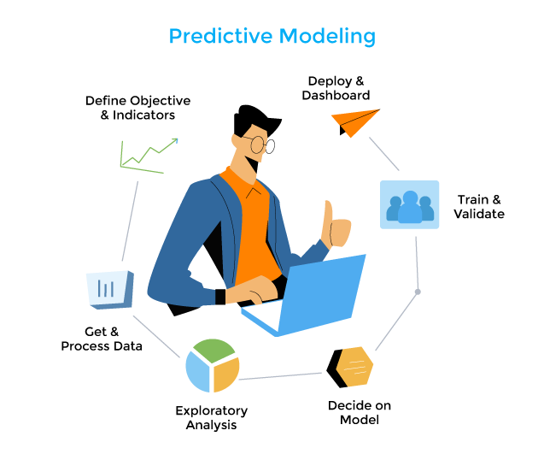
Definitions
Artificial Intelligence’s (AI) use had rapidly increased in recent years.
Machine Learning: How computers “think” and process data “intelligently”
Predictive Analytics: Various statistical techniques are used to estimate or “predict” outcomes based on historical and current data.
Predictive Modeling: The implementation of machine learning algorithms in predictive analytics.

Slide 4

Trends & Uses
Predictive analytics and predictive modeling rose from a post-World War II society and focused on the foundational concepts of linear regression and time-series analysis.
Today, the Internet of Things (IoT) allows for real-time analysis and forecasting.
In healthcare: 66% of healthcare leaders in the U.S. report implementing predictive analytics into their practices
Personalized treatment plans
Streamlined managerial practices
Anticipating public health crises

Slide 5
Predictive modeling Considerations
BENEFITS
RISKS/CHALLENGES
Ability to make data-driven decisions
Optimization of resource allocation and usage
Reducing administrative time and tasks
Analyze large quantities of data
Data that is low-quality
Electronic health records, lab results, and patient surveys,
Data can often be inconsistent
Security concerns around data
Conforming to data governance (HIPAA)

Slide 6
Predictive modeling At Cotiviti
CURRENTLY
POTENTIALLY
Cotiviti has already implemented predictive modeling for clinical decision making and pattern recognition.
Cotiviti offers many services, several of which include the use of machine learning:
Risk Adjustment:
Suspect Analytics: Effectively identify members with suspected but potentially undocumented conditions.
Cotiviti Retail Pillars of Payment Integrity:
Acceleration, Accuracy, Performance, Process Improvement, Flexibility
Potential Implementation Areas: Performance & Process Improvement
Improve performance process by using data to predict overpayments or by identifying tends.
Mitigate risks by predicting potential issues and preventing their occurrence.

Slide 7
Predictive Modeling demonstration - Overview
BACKGROUND
OUTCOME
Project: USAID Delivery Delay Predictor
Reasoning: Clinical Decision Making and Pattern Recognition is highly relevant in effective supply chain management.
Many of the products in the data were related to health care
Data: ARV and HIV lab shipments, pricing, and supply chain expenses.
Delivery Form: A simple web application that accepts user input that is evaluated by the trained model.
Algorithm: RandomForestRegressor model to predict delivery delays.
Mean Squared Error (MSE): Approximately 0.4
Model Components:
Features: Fulfillment transportation, product lead time ratio, days since order, country encoding.
Output: Delivery delay in days.
Future Development: Enhancing the model, calculating the estimated delivery date, improving UI/UX and deploying the model

Slide 8

Thank You

